Slide 1
Randomized Algorithms CS648
Lecture 17
Randomized Algorithm for Min-cut (part I)

Slide 2
Min-cut
A Randomized Algorithm

Slide 3



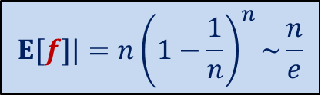


Graph and Multi-graph
A multi-graph may have:
More than one edge between a pair of vertices
No self loop
$$u$$
$$a$$
$$l$$
$$v$$
$$x$$
$$b$$
$$h$$
$$w$$

Slide 4

Min-Cut
$G=(V,E)$: undirected connected graph
Definition (cut):
A subset $C⊆E$whose removal disconnects the graph.
Definition (min-cut): A cut of smallest size.
Problem Definition: Design algorithm to compute min-cut of a given graph.

Slide 5
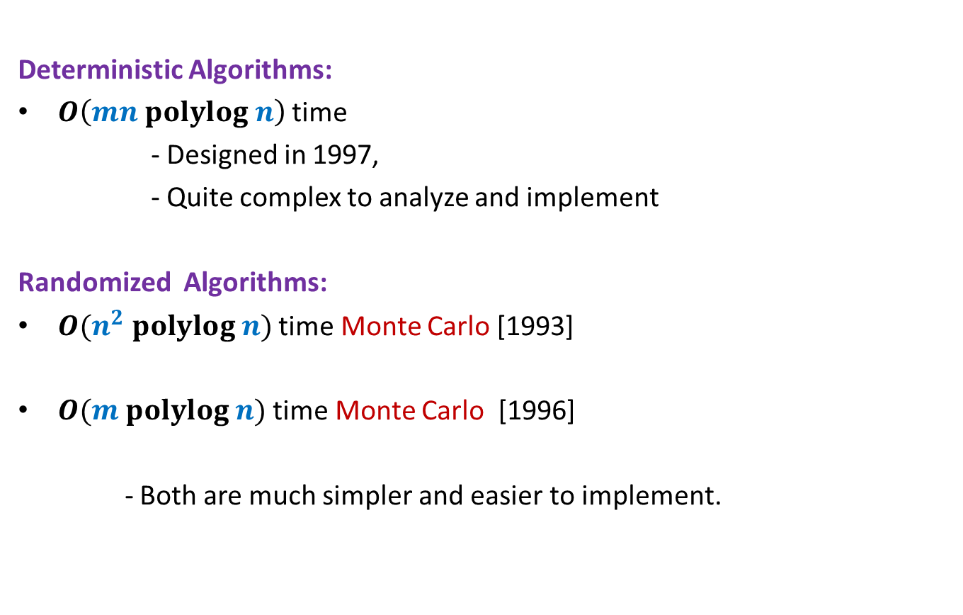
Min-Cut
Deterministic Algorithms:
$O\left(mn polylog n\right)$ time
- Designed in 1997,
- Quite complex to analyze and implement
Randomized Algorithms:
$O(n^{2} polylog n)$ time Monte Carlo [1993]
$O(m polylog n)$ time Monte Carlo [1996]
- Both are much simpler and easier to implement.

Slide 6
some basic facts

Slide 7
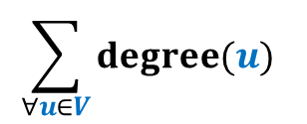



Min-Cut
Question: How many cuts ?
Answer: $\frac{2^{n}−2}{2}$
Question : what is relation between degree($u$) and size of min-cut ?
Answer: size of min-cut $≤$ degree($u$)
Question : If size of min-cut is $k$, what can be minimum value of $m$ ?
Answer: $\frac{nk}{2}$
These answers are correct there as well.
How about cuts in multi-graph ?
$$\sum_{∀u∈V}{degree(u)}$$
$$nk≤$$
$$=2m$$

Slide 8








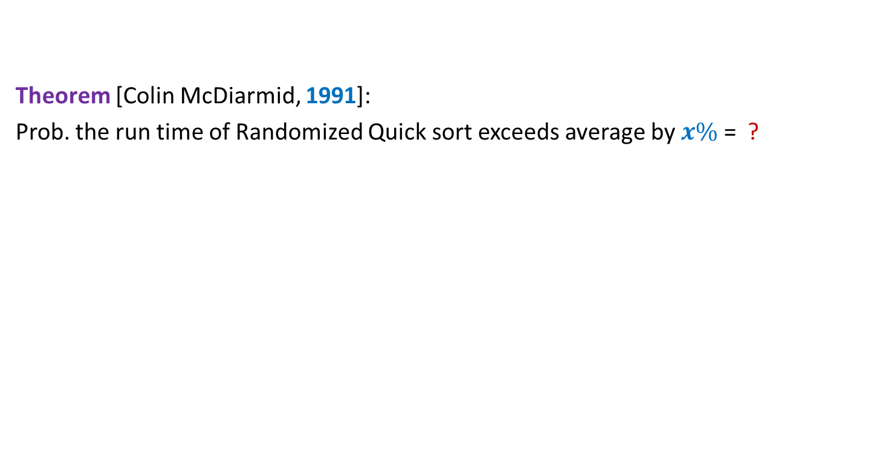










Contract($G,e$)
$$u$$
$$x$$
$$a$$
$$l$$
$$v$$
$$y$$
$$b$$
$$h$$
$$w$$
Contract($G,(x,y))$
$$u$$
$$a$$
$$l$$
$$v$$
$$xy$$
$$b$$
$$h$$
$$w$$

Slide 9
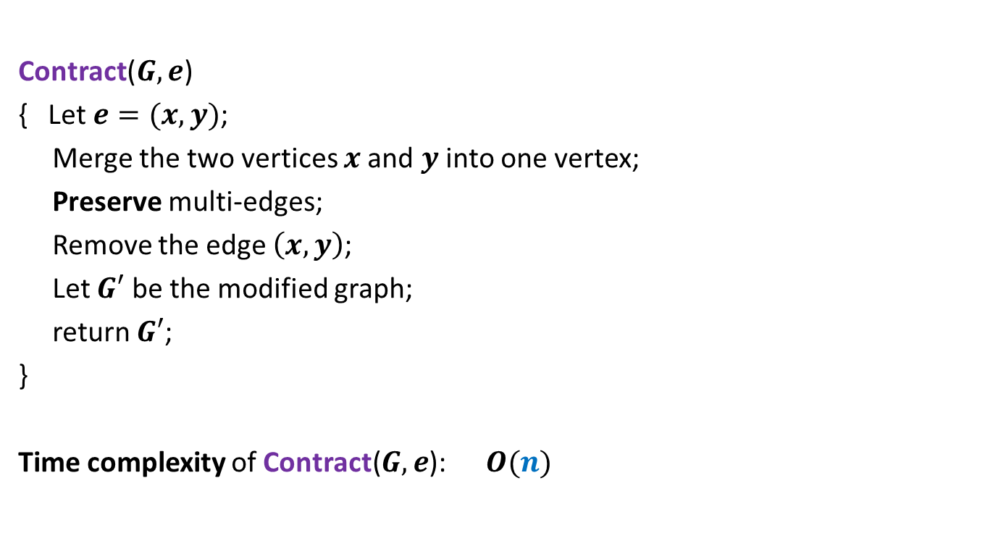

Contract($G,e$)
Contract($G,e$)
{ Let $e=(x,y)$;
Merge the two vertices $x$and $y$ into one vertex;
Preserve multi-edges;
Remove the edge $\left(x,y\right)$;
Let $G′$ be the modified graph;
return $G′$;
}
Time complexity of Contract($G,e$): $O(n)$

Slide 10

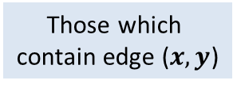


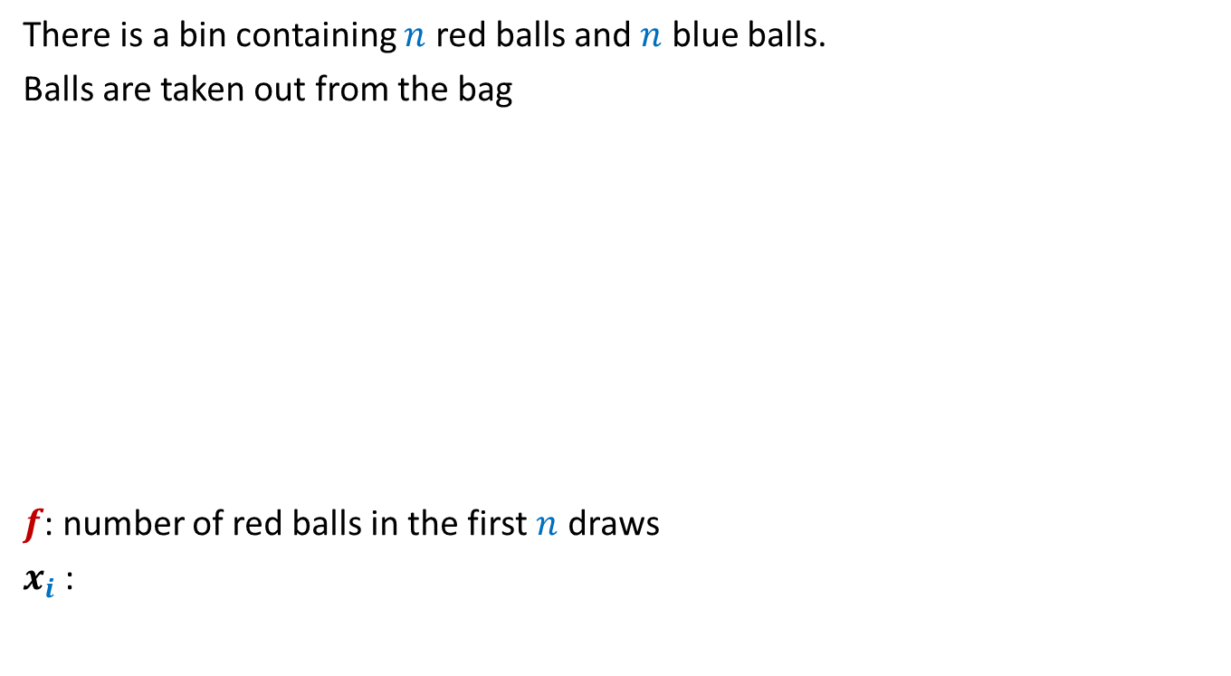
Contract($G,e$)
$$u$$
No
$$x$$
$$a$$
$$l$$
$$v$$
$$y$$
$$b$$
$$h$$
$$w$$
Contract($G,(x,y))$
$$u$$
$$a$$
$$l$$
$$v$$
$$xy$$
$$b$$
$$h$$
$$w$$
Which cuts of $G$ are absent from $G′$ ?
Is a cut of $G$ also a cut of $G′$ ?
Observation:
Every cut of $G′$ is also a cut of $G$.
$$G′$$
Those which
contain edge ($x,y$)
Yes
Yes

Slide 11

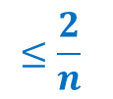
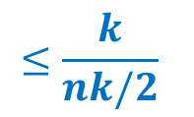
Contract($G,e$)
Let $k$ be the size of min-cut of $G$.
Let $C$ be any min-cut of $G$.
Let $G′$ be the graph after Contract($G,e$).
Question: Under what circumstance will $C$ be a cut of $G′$ ?
Answer: if $e∉C$.
Question: If $e$ is selected randomly uniformly,
what is the probability that $C$ is absent from $G′$ ?
Answer: $\frac{k}{m}$
$$≤\frac{k}{nk/2}$$
$$≤\frac{2}{n}$$

Slide 12
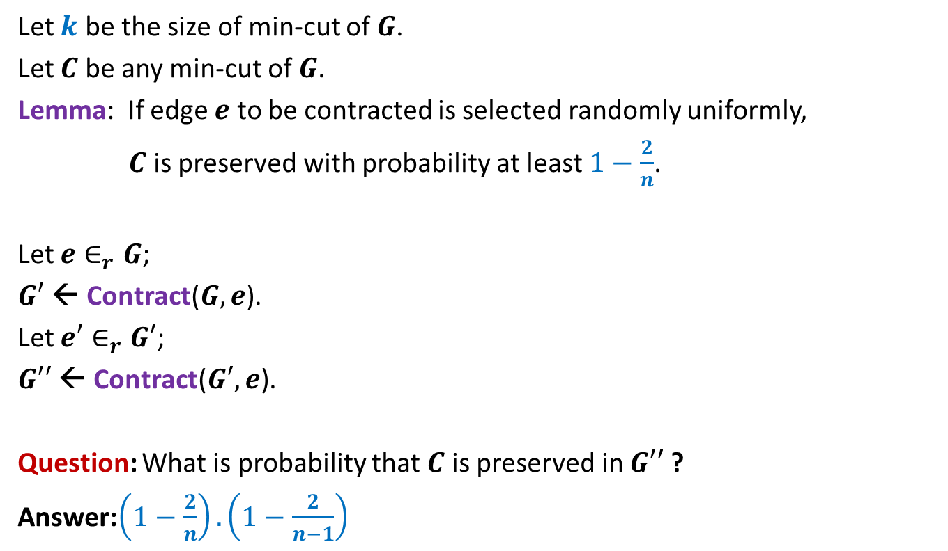
Contract($G,e$)
Let $k$ be the size of min-cut of $G$.
Let $C$ be any min-cut of $G$.
Lemma: If edge $e$ to be contracted is selected randomly uniformly,
$C$ is preserved with probability at least $1−\frac{2}{n}$.
Let $e∈_{r}G$;
$G′$ ← Contract($G,e$).
Let $e′∈_{r}G′$;
$G′′$ ← Contract($G′,e$).
Question: What is probability that $C$ is preserved in $G′′$ ?
Answer:$\left(1−\frac{2}{n}\right).\left(1−\frac{2}{n−1}\right)$

Slide 13


Algorithm for min-cut
Min-cut($G$):
{ Repeat ?? times
{
Let $e∈_{r}G$;
$G$ ← Contract($G,e$).
}
return the edges of multi-graph $G$;
}
Running time: $O(n^{2})$
$$n−2$$

Slide 14
3
1
3
1
5
5
2
2
4
4
1
1
3,4
3,4
Sample executions
5
5
2
2
1
3,4,5
1
,3,4
2
5
2
1,2,3,4
1
2,3,4,5
5
Success ☺
Failure ☹

Slide 15

Algorithm for min-cut
Question: What is probability that $C$ is preserved during the algorithm ?
Answer: $\left(1−\frac{2}{n}\right).\left(1−\frac{2}{n−1}\right).\left(1−\frac{2}{n−2}\right)…\frac{3}{5}.\frac{2}{4}.\frac{1}{3}$
= $\left(\frac{n−2}{n}\right).\left(\frac{n−3}{n−1}\right).\left(\frac{n−4}{n−2}\right)…\frac{3}{5}.\frac{2}{4}.\frac{1}{3}$
= $\frac{2}{n}.\frac{1}{n−1}$
>$\frac{1}{n^{2}}$

Slide 16
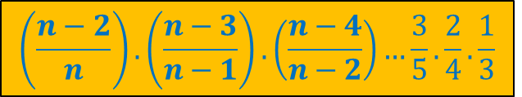
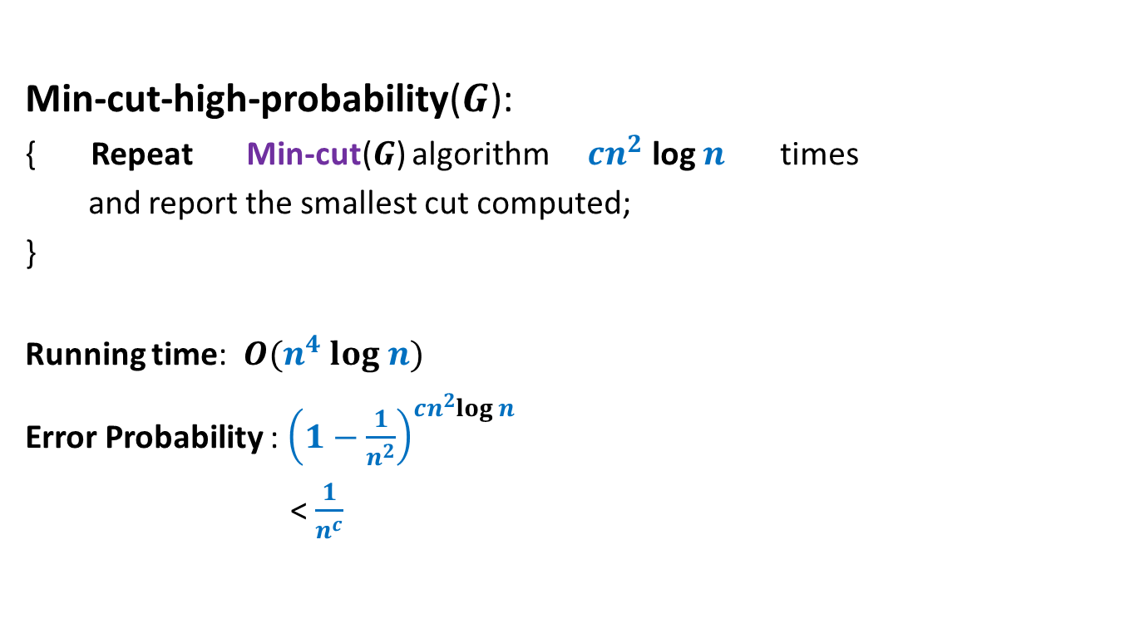
Algorithm for min-cut
Min-cut-high-probability($G$):
{ Repeat Min-cut($G$) algorithm $cn^{2}$ log $n$ times
and report the smallest cut computed;
}
Running time: $O(n^{4} log n)$
Error Probability : ${\left(1−\frac{1}{n^{2}}\right)}^{cn^{2}log n}$
< $\frac{1}{n^{c}}$
$$\left(\frac{n−2}{n}\right).\left(\frac{n−3}{n−1}\right).\left(\frac{n−4}{n−2}\right)…\frac{3}{5}.\frac{2}{4}.\frac{1}{3}$$

Slide 17
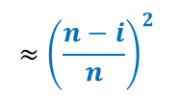
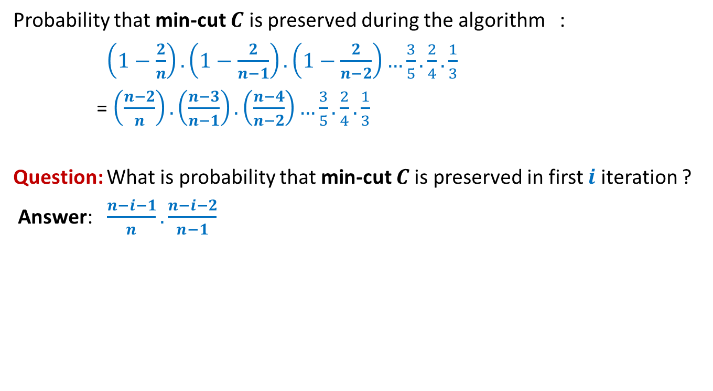
Algorithm for min-cut
Probability that min-cut $C$ is preserved during the algorithm :
$\left(1−\frac{2}{n}\right).\left(1−\frac{2}{n−1}\right).\left(1−\frac{2}{n−2}\right)…\frac{3}{5}.\frac{2}{4}.\frac{1}{3}$
= $\left(\frac{n−2}{n}\right).\left(\frac{n−3}{n−1}\right).\left(\frac{n−4}{n−2}\right)…\frac{3}{5}.\frac{2}{4}.\frac{1}{3}$
Question: What is probability that min-cut $C$is preserved in first $i$ iteration ?
Answer: $\frac{n−i−1}{n}.\frac{n−i−2}{n−1}$
$$≈{\left(\frac{n−i}{n}\right)}^{2}$$

Slide 18


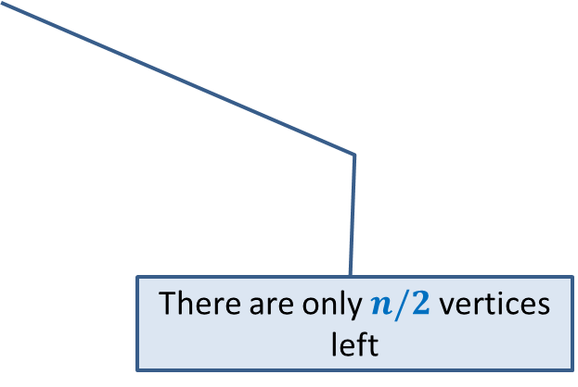
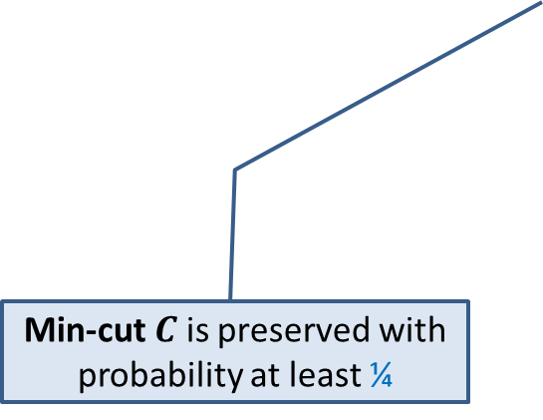
Key observations about Min-Cut algorithm
Algorithm performs $n−2$ contractions :
$$n/2$$
Min-cut $C$ is preserved with probability at least ¼
There are only $n/2$ vertices left
Ponder over these insights before coming to the next class.

Slide 19
Computing A random no. from [$0,2^{k}−1$]
using a fair coin

Slide 20



Computing a random no. from [$0,2^{k}−1$]
Problem:
Given a positive integer $k$, design an algorithm to compute a random number
uniformly distributed in [$0,2^{k}−1$].
Solution:
Generate_Random($k$) //Generates a random no in the range [$0,2^{k}−1$].
$X$←$0$;
For $i$ =$1$ to $k$ do
Toss the coin;
If outcome is head $s$ ← $1$;
Else $s$ ← $0$;
$X$ ← $X⋅2+s$;
}
return $X$;
Let $t∈\text{[}0,2^{k}−1\text{].}$
$$\frac{1}{2^{k}}$$
P($X=t$) = ?
Binary-representation of $t$
$$0$$ | $$1$$ | $$0$$ | $$1$$ | $$1$$ | $$1$$ | $$0$$ | $$1$$
$$1 2 … k$$

Slide 21
Computing A random no. from [$0,m−1$]
using a fair coin

Slide 22
Computing a random no. from [$0,m−1$]
Problem:
Given a positive integer $m$, design an algorithm to compute a random number
uniformly distributed in [$0,m−1$].
Solution:
Compute smallest $k$ such that $m≤2^{k}$
Repeat
$X$← Generate_Random($k$)
until $X∈$ [$0,m−1$].
return $X$;
$$0$$
$$m−1$$
$$2^{k}−1$$
Let $t∈\text{[}0, m−1\text{].}$
P($X=t | X∈ \text{[}0,m−1\text{]}$)
$$=\frac{\text{P}\text{(}X=t\text{)}}{P(X∈ \text{[}0,m−1])}$$
$$= \frac{ \frac{1}{2^{k}} }{\frac{m}{2^{k}}}$$
$$= \frac{ 1 }{m}$$

Slide 23


Computing a random no. from [$0,m−1$]
Problem:
Given a positive integer $m$, design an algorithm to compute a random number
uniformly distributed in [$0,m−1$].
Solution:
Compute smallest $k$ such that $m≤2^{k}$
Repeat
$X$← Generate_Random($k$)
until $X∈$ [$0,m−1$].
return $X$;
$$0$$
$$m−1$$
$$2^{k}−1$$
$Y$ : the number of iterations of repeat loop
A geometric random variable with parameter > $\frac{1}{2}$

Slide 24
Helping Ram distribute the apple among two friends
Using least no. of random bits.

Slide 25
Exercise 1
Ram has an apple.
Ram has $4$ friends.
Ram wants to give it to only one of them.
He decides to give it uniformly randomly.
Ram has a fair coin.
Help Ram achieve this goal.
Toss the coin 2 times.
Outcome of tosses | Action
HH
Give it to Friend 1
HT
Give it to Friend 2
TH
Give it to Friend 3
TT
Give it to Friend 4

Slide 26
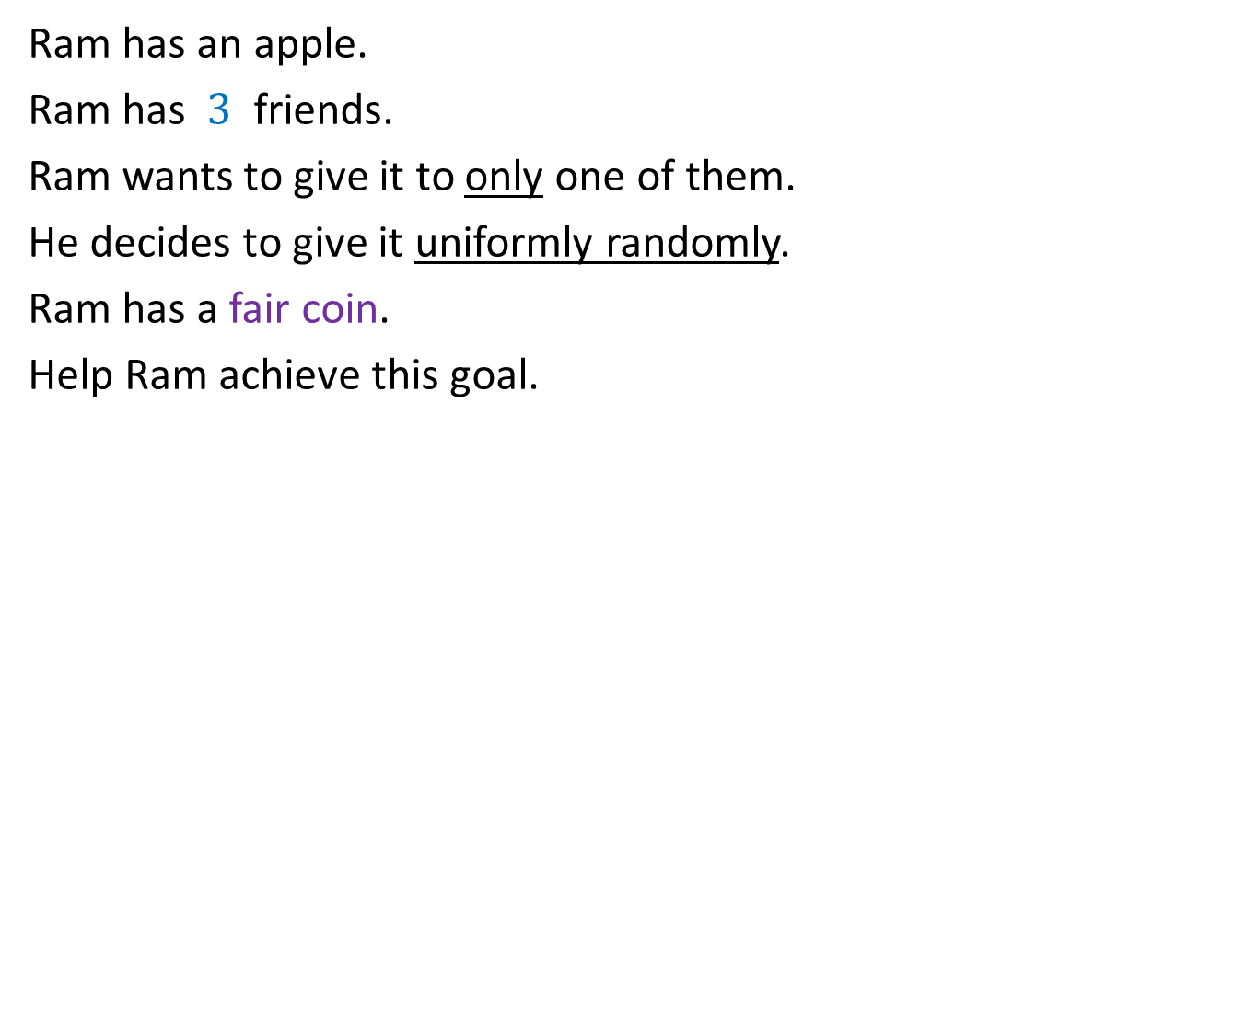
Exercise 2
Ram has an apple.
Ram has $3$ friends.
Ram wants to give it to only one of them.
He decides to give it uniformly randomly.
Ram has a fair coin.
Help Ram achieve this goal.
Toss the coin 2 times.
Outcome of tosses | Action
HH
Give it to Friend 1
HT
Give it to Friend 2
TH
Give it to Friend 3
?
TT
Toss the coin twice again

Slide 27
Helping Ram distribute the apple among two friends
Using least no. of random bits.

Slide 28

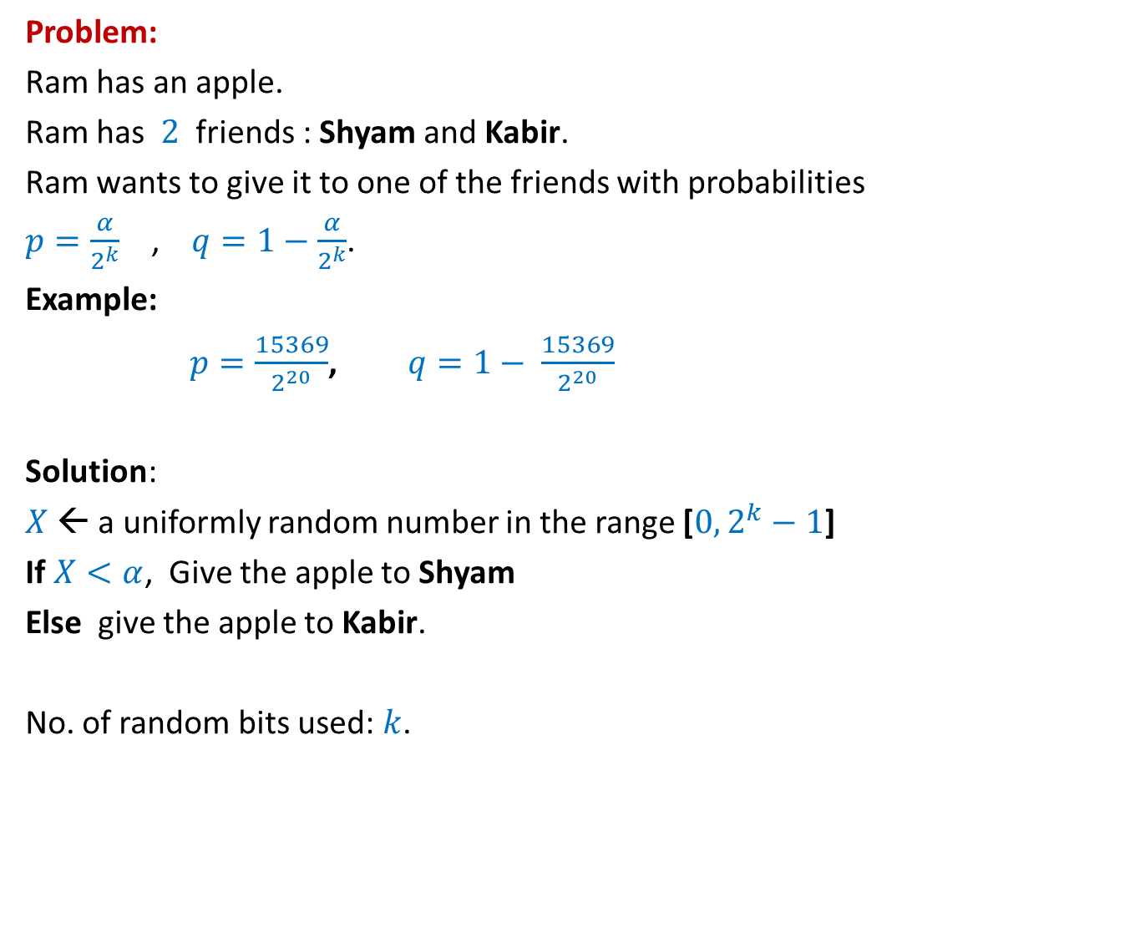
How many random bits ?
Problem:
Ram has an apple.
Ram has $2$ friends : Shyam and Kabir.
Ram wants to give it to one of the friends with probabilities
$p=\frac{α}{2^{k}}$ , $q=1−\frac{α}{2^{k}}$.
Example:
$p=\frac{15369}{2^{20}}$, $q=1− \frac{15369}{2^{20}}$
Solution:
$X$← a uniformly random number in the range [$0,2^{k}−1$]
If $X<α$, Give the apple to Shyam
Else give the apple to Kabir.
No. of random bits used: $k$.
$α$ : any given positive integer $≤2^{k}$
Can we do it in still fewer bits ?
Yes, <2 in expectation. We shall see in the next class ☺

